Slide 1
Estimating parameters from data
Portions based on www.stats.ox.ac.uk/~mcvean/DTC/STAT/Lectures/old/Likelihood.ppt Jody Hey 2020

Slide 2

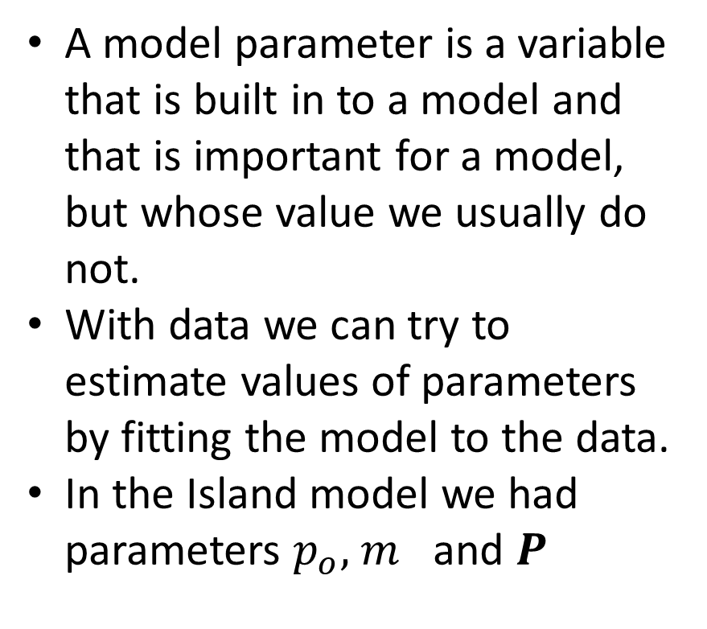


What is a model parameter?
A model parameter is a variable that is built in to a model and that is important for a model, but whose value we usually do not.
With data we can try to estimate values of parameters by fitting the model to the data.
In the Island model we had parameters $p_{o},$ $m$ and $P$
Island
$$p_{o}$$
migration
$m$
$$P$$
Mainland

Slide 3
Questions to ask…
How can I estimate model parameters from data?
What should I worry about when choosing between estimators?
Is there some optimal way of estimating parameters from data?

Slide 4
Parameter estimation
All data analysis involves fitting data to a model
All data have sources of noise, and most models allow for randomness
For many analyses we can formulate questions in terms of making statements about underlying parameters of a model
We want to devise a framework for estimating those parameters and making statements about our certainty
In this lecture we will look at several different approaches to making such statements
Moment estimators
Least Squares (briefly)
Likelihood

Slide 5
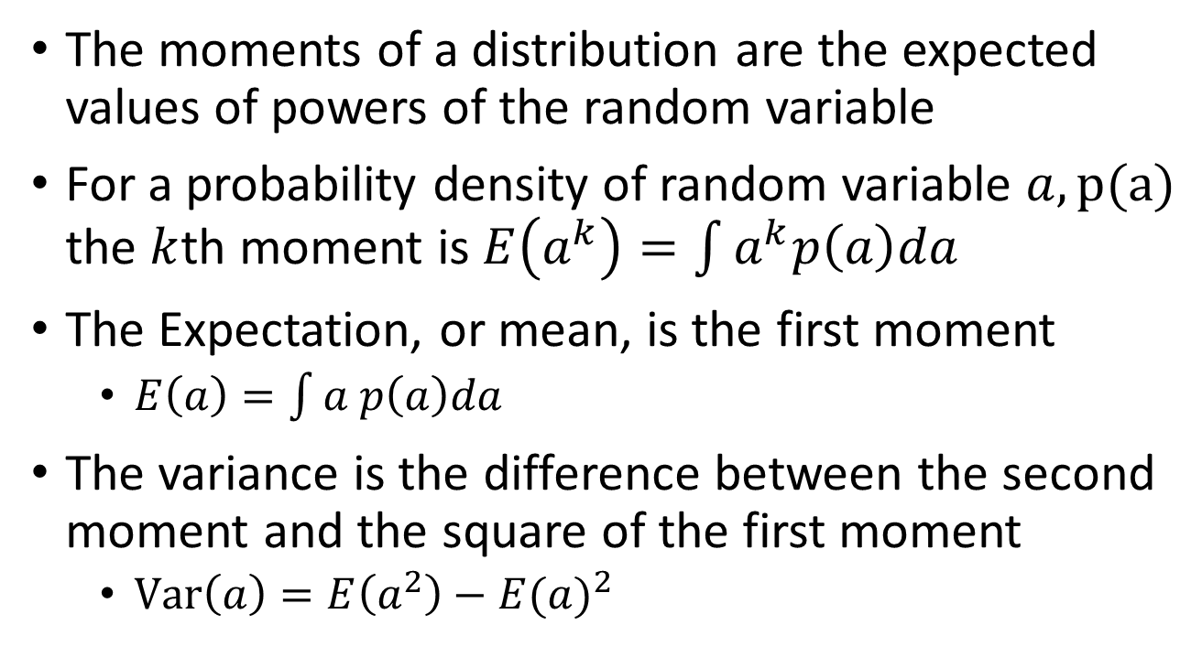





Moments of a probability distribution
The moments of a distribution are the expected values of powers of the random variable
For a probability density of random variable $a, p(a)$ the $k$th moment is $E\left(a^{k}\right)=\int{a^{k}p\left(a\right)da}$
The Expectation, or mean, is the first moment
$E\left(a\right)=\int{a p\left(a\right)da}$
The variance is the difference between the second moment and the square of the first moment
$Var\left(a\right)=E\left(a^{2}\right)−{E(a)}^{2}$

Slide 6
Parameter estimate by the “method of moments”
If a model parameter is a moment of a probability distribution, or if it is a function of one or more moments of a probability distribution,
then you can estimate the parameter(s) by estimating the moment(s) using data

Slide 7
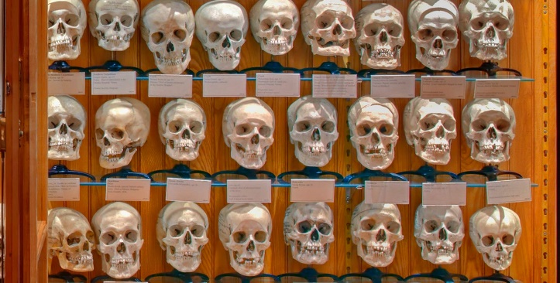

Moment estimation, example 1
Suppose you are the distribution of skull cranial volume with samples from the Mütter museum and you want to estimate the expectation (mean, $μ$) and variance ($σ^{2})$.
To apply the method of moments to estimate the mean and variance of the distribution, you calculate the mean and variance of the sample.
Estimates

Slide 8
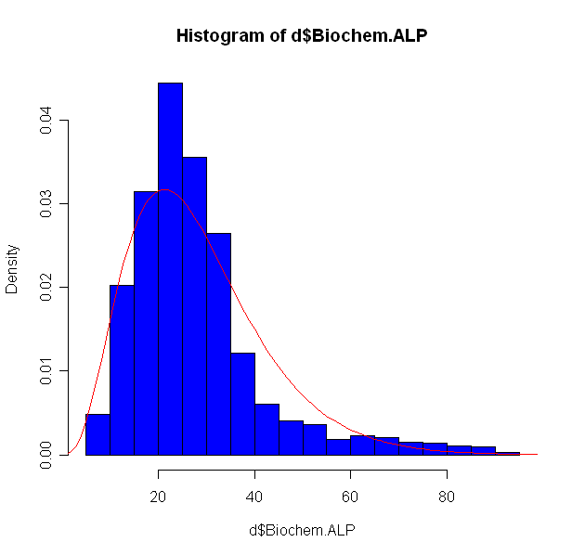
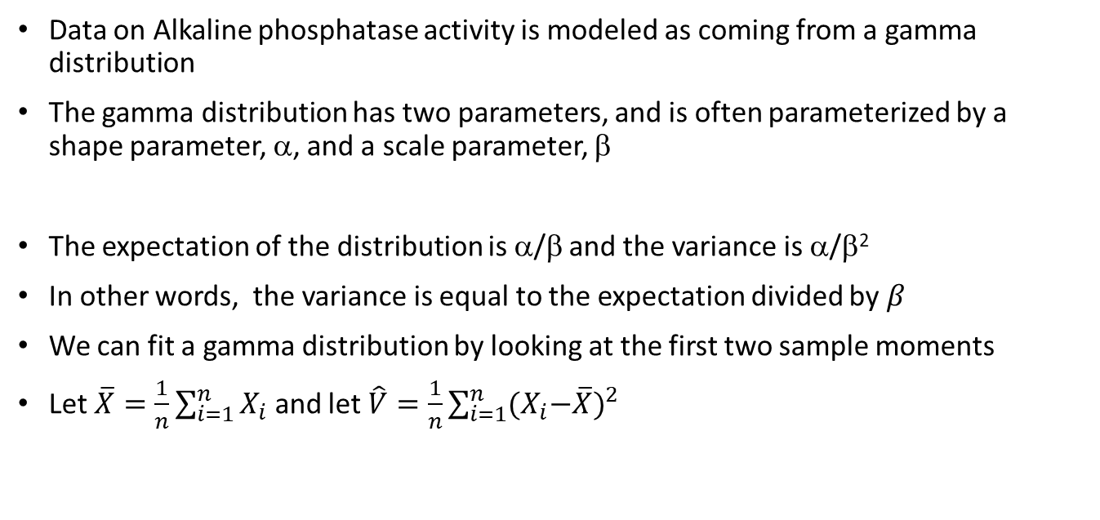

Moment estimation, example 2
Data on Alkaline phosphatase activity is modeled as coming from a gamma distribution
The gamma distribution has two parameters, and is often parameterized by a shape parameter, α, and a scale parameter, β
The expectation of the distribution is α/β and the variance is α/β²
In other words, the variance is equal to the expectation divided by $β$
We can fit a gamma distribution by looking at the first two sample moments
Let $\overline{X}=\frac{1}{n}\sum_{i=1}^{n}{X_{i}}$ and let $\hat{V}=\frac{1}{n}\sum_{i=1}^{n}{{{(X}_{i}−\overline{X})}^{2}}$
Alkaline phosphatase measurements in 2019 mice
α = 4.03
β = 0.14
$$\hat{β}=\overline{X}/\hat{V}$$
$$\hat{α }=\overline{X}\hat{β}$$

Slide 9
Estimator quality: Bias and Variance
When you estimate a parameter using a sample of data, that parameter estimate is itself subject to random variation - a different sample would give you a different estimate.
If you ran many experiments, or collected many data sets, under the same model.
You could estimate the expected value (mean) of the parameter estimates
You could estimate the variance among the estimates
If you have two different kinds of estimators (ways of estimating parameters), then it is possible that one method works better than the other
We prefer estimators that have lower variance
We also prefer estimators that have lower bias
Estimator Bias Is the difference between the expected value of an estimate and the true value of the parameter

Slide 10
Problems with moment estimation
It is not always possible to exactly match sample moments with their expectation
It is not clear when using moment methods how much of the information in the data about the parameters is being used
Often not much..

Slide 11
Alternatives to Moment Estimation
Least squares estimation
A commonly-used approach to fitting models to data is called least squares estimation
This attempts to minimise the sum of the squares of residuals
A residual is the difference between an observed and a fitted value
Maximum Likelihood estimation

Slide 12
Is there an optimal way to estimate parameters?
Is there a way to be sure that we use all of the information that is in the data that has something to do with the parameters.
For any model the maximum information about model parameters is obtained by considering the likelihood function
The likelihood function is proportional to the probability of observing the data given a specified parameter value
The likelihood function is a mathematical function of both the data and the model parameters.
We can calculate different likelihoods – the data is fixed, but we can vary the values of the model parameters
One natural choice for point estimation of parameters is the maximum likelihood estimate, the parameter values that maximise the probability of observing the data
The maximum likelihood estimate (mle) has some useful properties (though is not always optimal in every sense )

Slide 13
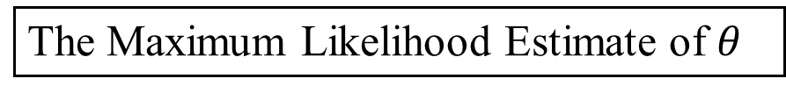


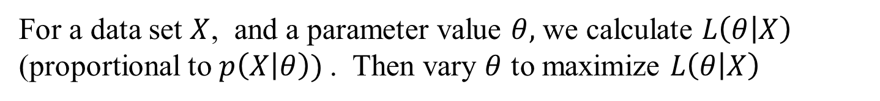
Maximum Likelihood diagram
For a data set $X$, and a parameter value $θ,$ we calculate $L\left(θ | X\right)$ (proportional to $p\left(X | θ\right))$. Then vary $θ$ to maximize $L\left(θ | X\right)$
The Maximum Likelihood
$$L\left(θ | X\right)$$
$θ$
The Maximum Likelihood Estimate of $θ$

Slide 14
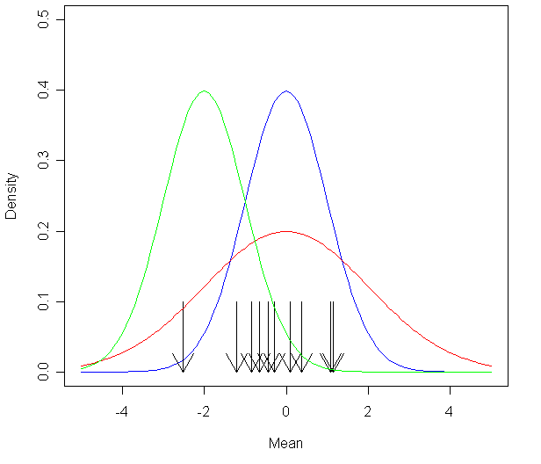
Developing an intuition of likelihood:
We want a model that fits the data
So we look for a model under which the data seems pretty probable
Consider several models and pick the best
Locations of sampled values on the x axis

Slide 15
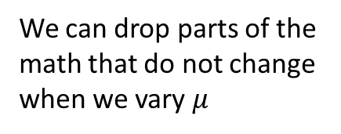
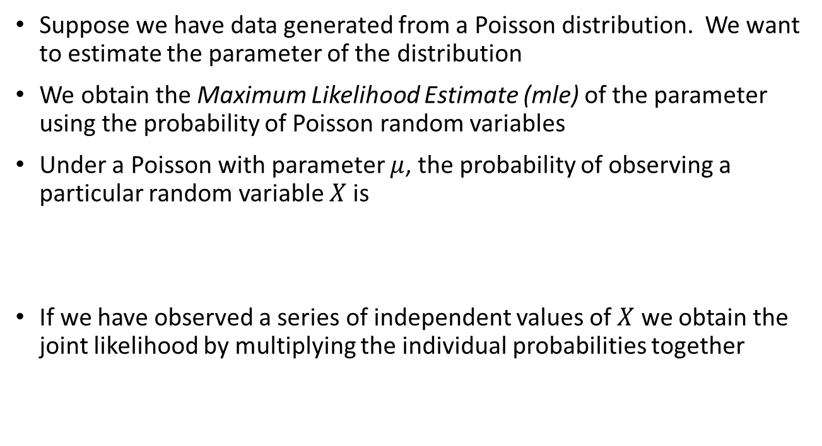
maximum likelihood example
Suppose we have data generated from a Poisson distribution. We want to estimate the parameter of the distribution
We obtain the Maximum Likelihood Estimate (mle) of the parameter using the probability of Poisson random variables
Under a Poisson with parameter $μ$, the probability of observing a particular random variable $X$is
If we have observed a series of independent values of $X$ we obtain the joint likelihood by multiplying the individual probabilities together
We can drop parts of the math that do not change when we vary $μ$

Slide 16
Example continued
Note that in the likelihood function the factorials in the denominator have disappeared. This is because they provide a constant that does not influence the relative likelihood of different values of the parameter
It is usual to work with the log likelihood rather than the likelihood. Note that maximising the log likelihood is equivalent to maximizing the likelihood
We can find the mle using a graph, or by numerical optimization
Sometimes we can find the mle analytically by solving for the point in the probability density function where the derivative is zero
In the case of the sample from a Poisson distribution We can find the mle of the parameter analytically
Take the natural log of the likelihood function
Find where the derivative of the log likelihood is zero
Note that here the mle is the same as the moment estimator

Slide 17
Features of maximum likelihood estimate
The maximum likelihood estimate can be found either analytically or by numerical maximization
The mle is consistent in that it converges to the truth as the sample size gets infinitely large (a highly desirable property)
The mle is asymptotically efficient in that it achieves the minimum possible variance (the Cramér-Rao Lower Bound) as n→∞ (a highly desirable property)
However, the mle is often biased for finite sample sizes
This is not good, but oftentimes we can put up with this because other things are good
If you know how to calculate a likelihood for your model (i.e. the probability of the data, or something that is proportional to the probability of the data), this makes possible many other important kinds of statistical analyses
Estimating confidence intervals
Likelihood ratio tests
Bayesian methods

